Slide 1

Design Patterns
Closures
​
Aris Markogiannakis
City University - Short Courses
CS3606 : JavaScript 2: Advanced Javascript for Websites and Web

Slide 2
This week?
This week we will learn about:
Design Patterns
Closures

Slide 3
Module Pattern
A pattern is a reusable solution that be applied to commonly occurring problems in software design
Or code templates that can be adapted to solve problems in variety of situations
Notes:
https://developer.mozilla.org/en-US/docs/Web/JavaScript/Reference/Global_Objects/Array›

Slide 4
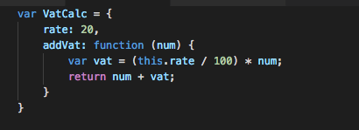
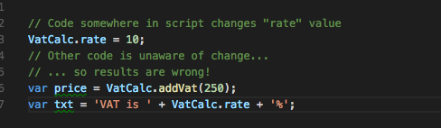

Module Pattern
But it is also possible for code outside the object to change its properties and methods
We can use its properties and methods throughout our script, which is useful:
We need to ensure robustness, we tend to want to prevent global scope from changing certain elements in our app.

Slide 5
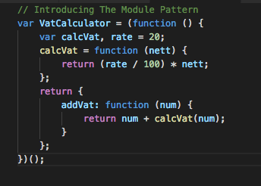
Module Pattern
One of the most common patterns is the Module Pattern
Extension to the object literal pattern and attempts to emulate object oriented language features that are not present in Javascript natively
The module is contained in the IIFE
The return value of the IIFE is stored in the global variable
Any variables defined inside the IIFE are private and cannot be accessed from global scope

Slide 6
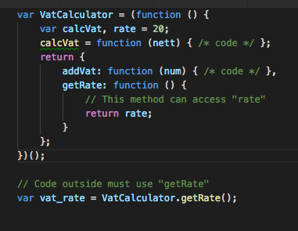
Partial Visibility
On our previous example, rate is completely hidden from the global scope.
It can not be changed (good)
It cannot be read (not always good)

Slide 7
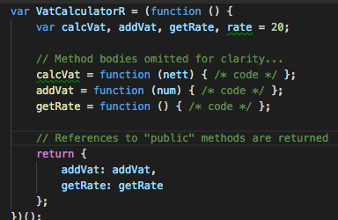

Revealing Module Pattern
In the revealing module pattern, ALL methods and properties are defined within the body of the IIFE.
The returned object contains references to the methods and properties you want to make public
Unlike the module pattern, no functions are defined in the returned object
Again, we simply use the method/properties of the returned object

Slide 8
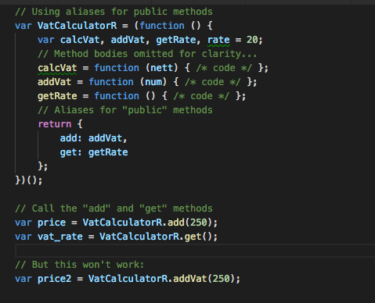
Aliases
We can use Aliases as well.

Slide 9
Benefits
The main benefits of using the revealing module pattern are code manageability and readability:
All of the methods are defined in one place
Methods can easily be made public/private by removing or adding one line to the returned object definition
Short aliases can be provided for the outside code to use, helping to create a fluent interface
Download the Session 4 exercises document from Moodle and do Exercise 1

Slide 10
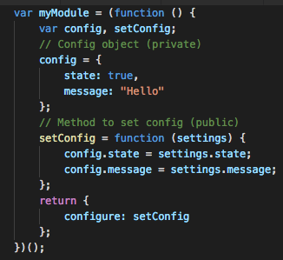
Module config objects
We can also use this technique with the revealing module pattern
By combining it with a configuration object stored within the module, we can create flexible, reusable programs
setConfig is public, code outside can change the settings but it can do this via configure()

Slide 11
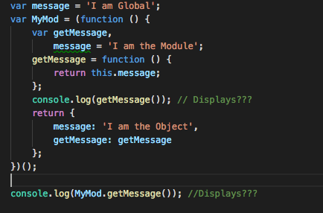
Modules and this
We can use the this keyword within our modules, but it will refer to something completely different, depending on the context it occurs in.
Notes:
The first console.log will display: I am Global ▶ Method is executed in the context of the IIFE, so this refers to the window • The second console.log will display: I am the Object ▶ Method is executed in the context of the returned object, and in objects, this refers to the object in which it is used

Slide 12
Closures - 100% interview question!
Each time a function is executed by the JavaScript engine, that execution is stored in memory
Any variables/functions defined/created within the function for that execution are stored with it
If we call the same function several times, each execution is stored separately
The item returned by the function can refer back to that stored execution
They call this a closure

